Slide 1
Neural
Ordinary
Differential
Equation(NODE)
Networks

Slide 2
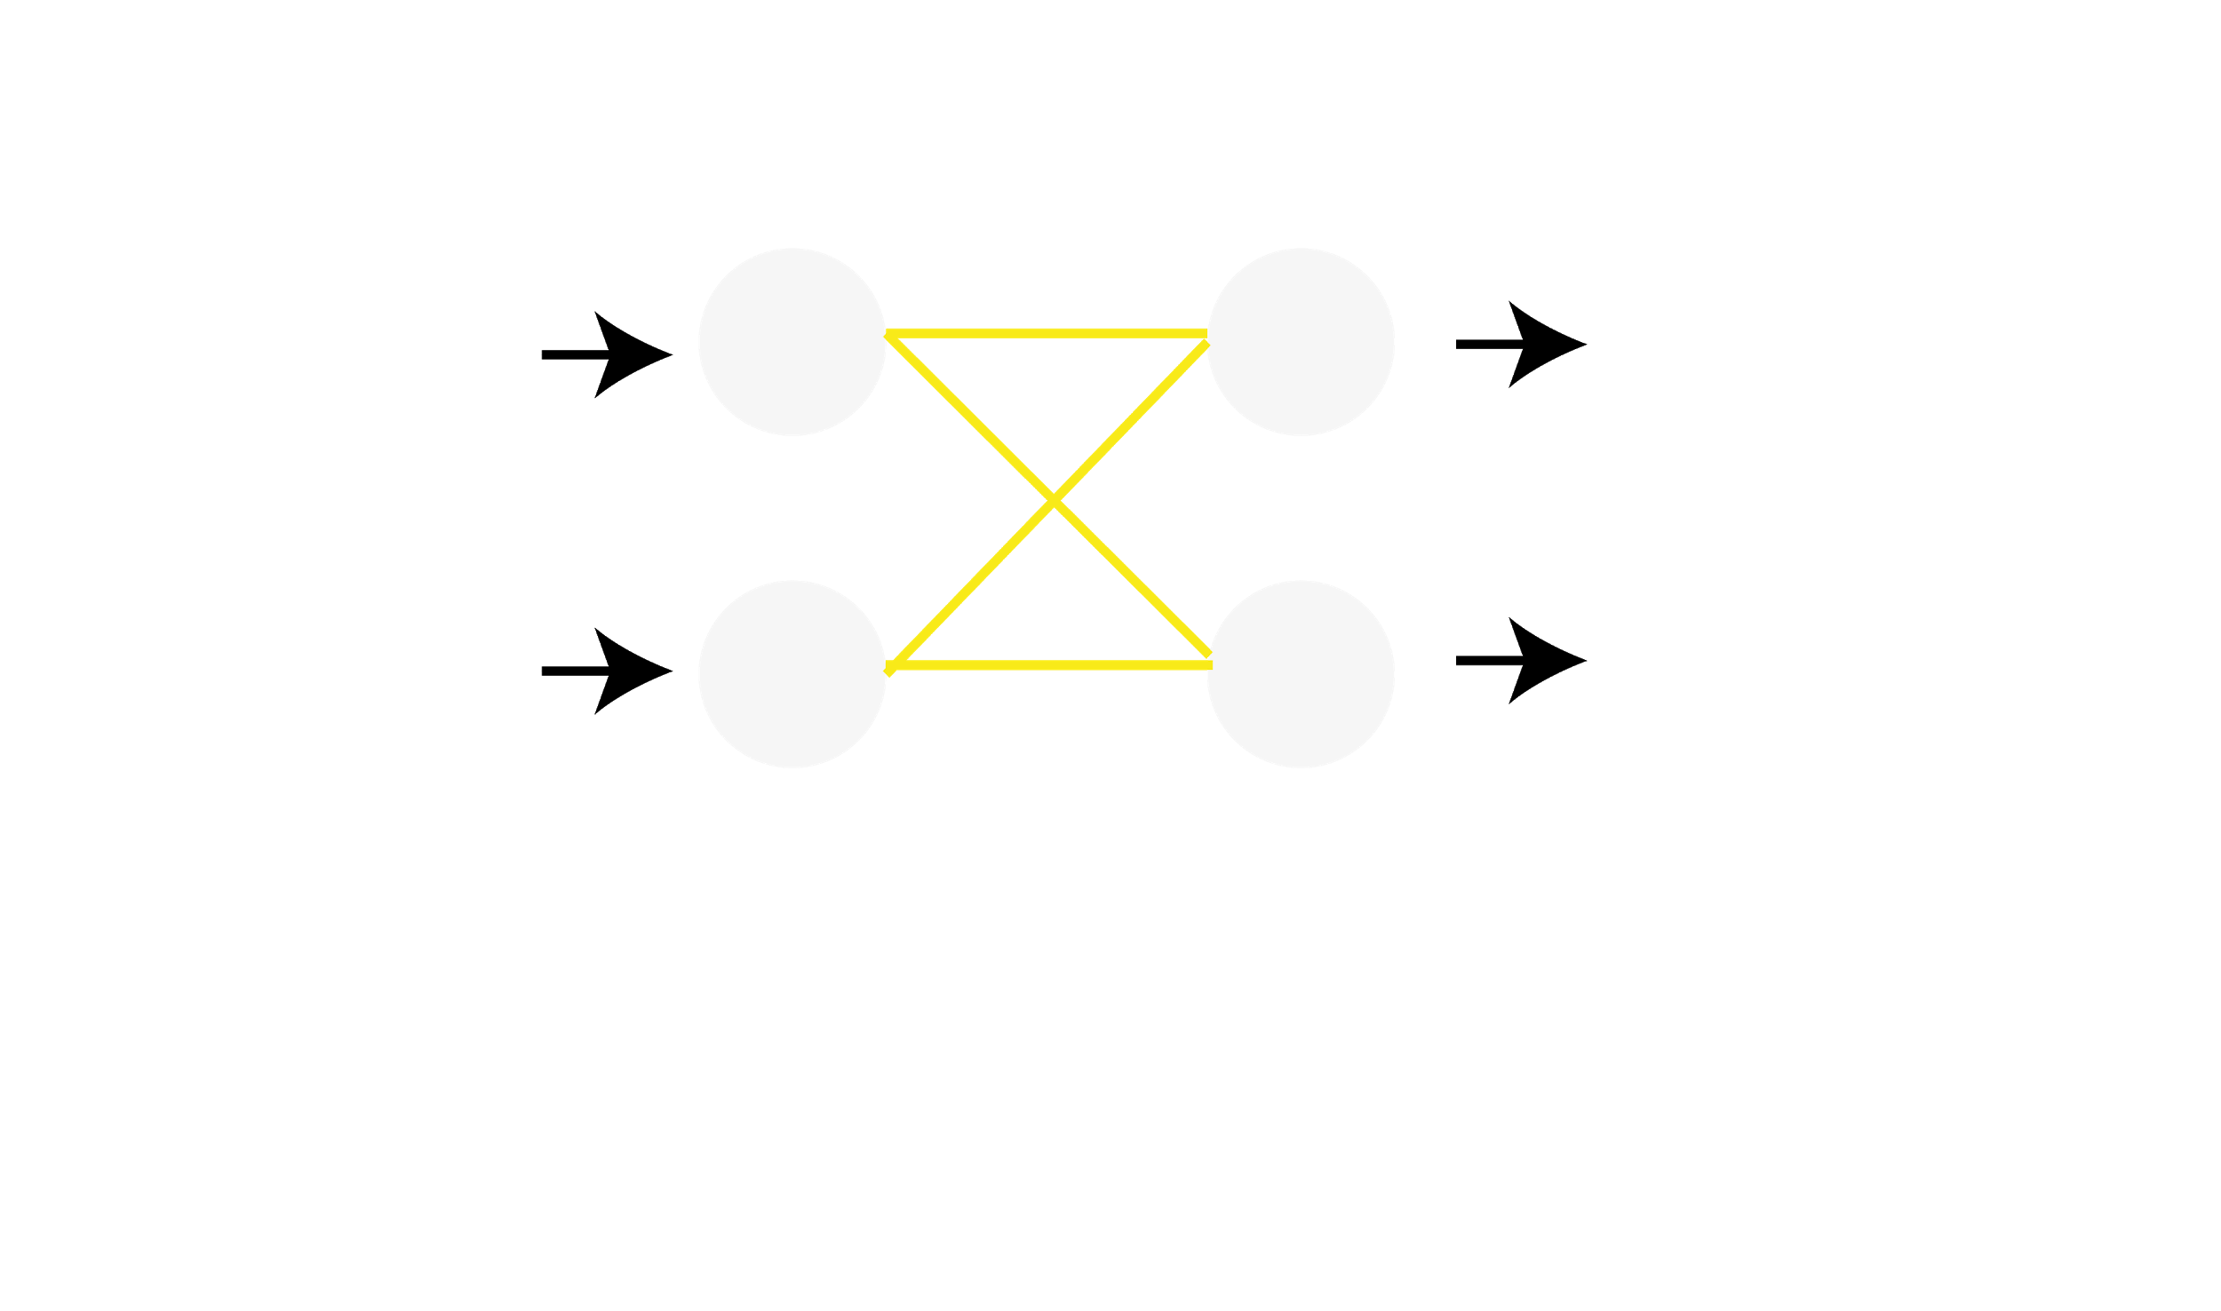
Classical neural net
Notes:
En till bild för den andra neuronen. Poängtera Dense!

Slide 3
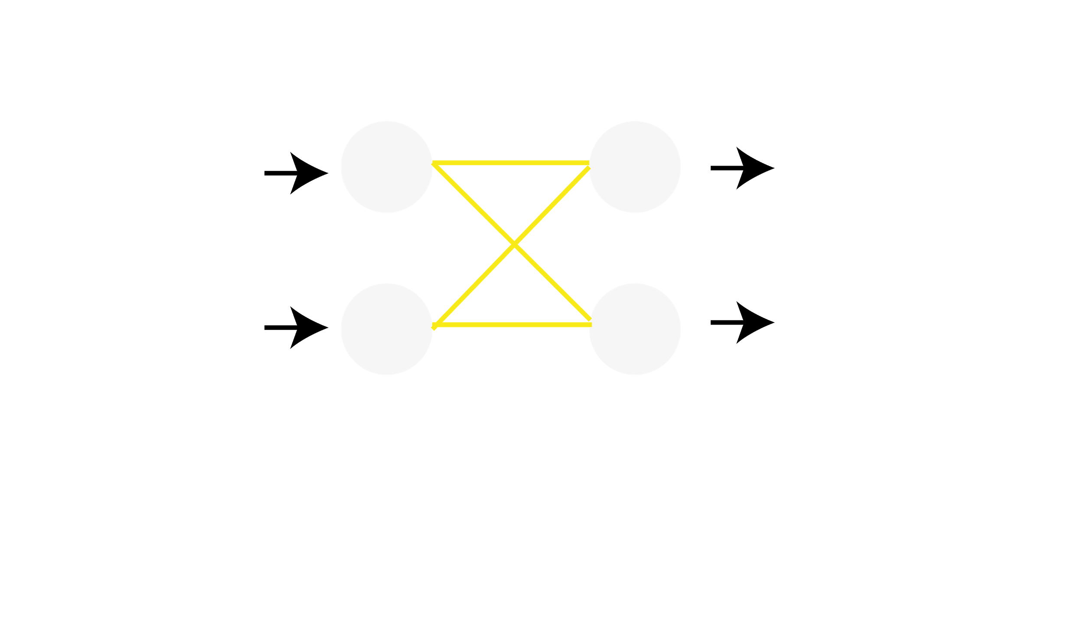
Residual neural net
Notes:
En till bild för den andra neuronen. Poängtera Dense!

Slide 4
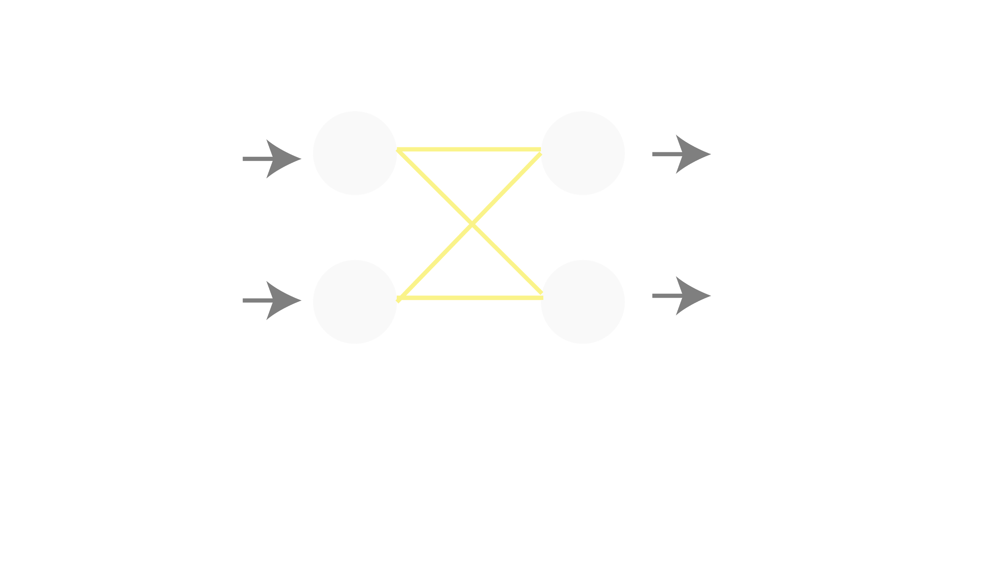
Residual neural net
Notes:
En till bild för den andra neuronen. Poängtera Dense!

Slide 5
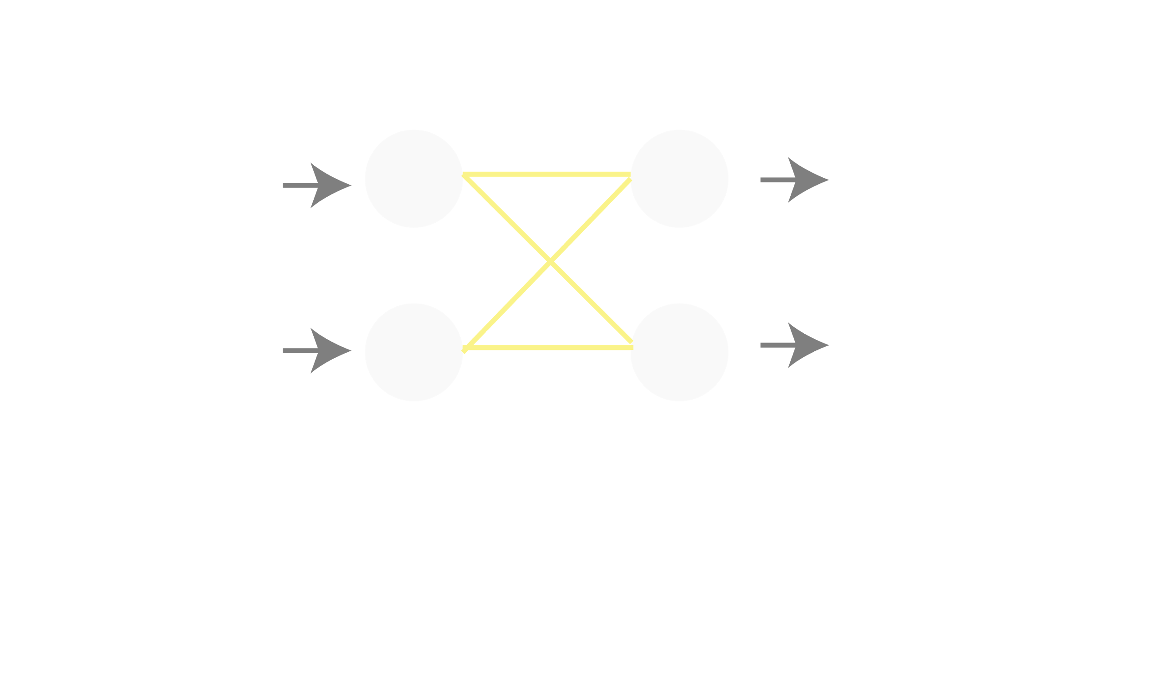
Residual neural net
Notes:
En till bild för den andra neuronen. Poängtera Dense!

Slide 6

Residual neural net
Notes:
En till bild för den andra neuronen. Poängtera Dense!

Slide 7

Neural ODE net
Notes:
We also add t0 and t1 as free parameters to optimize!

Slide 8
Direct NODE modelling
Notes:
Loss function as pleased and defining adjoint state as the derivative w.r.t the hidden states and its derivative w.r.t time/depth is given by adjoint method which is basically chain rule for Loss function, derivatives definition and taylor expansion. Also an ODE which can be solved but backwards in time so we get a(t0)!

Slide 9
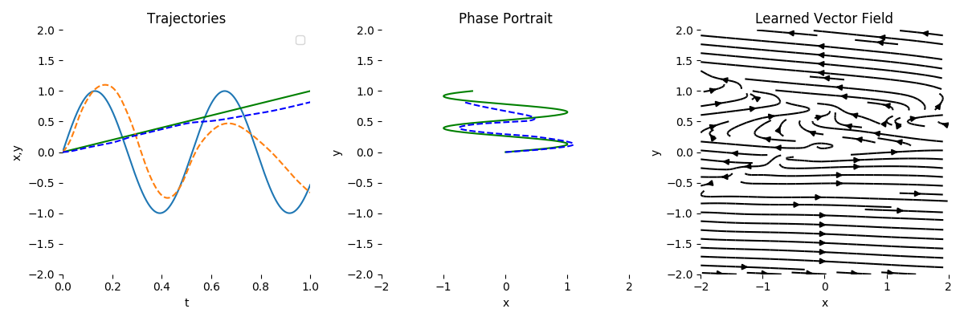
Neural ODE net
Notes:
Loss function as pleased and defining adjoint state as the derivative w.r.t the hidden states and its derivative w.r.t time/depth is given by adjoint method which is basically chain rule for Loss function, derivatives definition and taylor expansion. Also an ODE which can be solved but backwards in time so we get a(t0)!

Slide 10
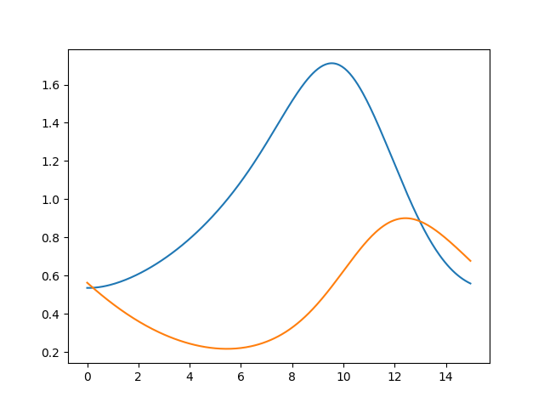
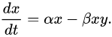
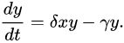
Differential Equation system:
Derivative well defined
Predator-prey system Prey:
Predator:
Fixed the constants and varied the starting position
Notes:
Derivative well defined!
Wanted to see if it could learn a vector field through integation!

Slide 11
Differential Equation system: Conclusions
It works as long as the derivative of the system is uniquely defined from the state
But why do this?
In the general case it is not faster to learn the vector field through integration instead of the actual curves
Does there exist cases were this is not the case?
Example: Restrict the neural network in some way!
Conservation of energy
Conservation of charge

Slide 12
Latent NODE modelling
Notes:
Loss function as pleased and defining adjoint state as the derivative w.r.t the hidden states and its derivative w.r.t time/depth is given by adjoint method which is basically chain rule for Loss function, derivatives definition and taylor expansion. Also an ODE which can be solved but backwards in time so we get a(t0)!

Slide 13

Latent NODE networks

Slide 14
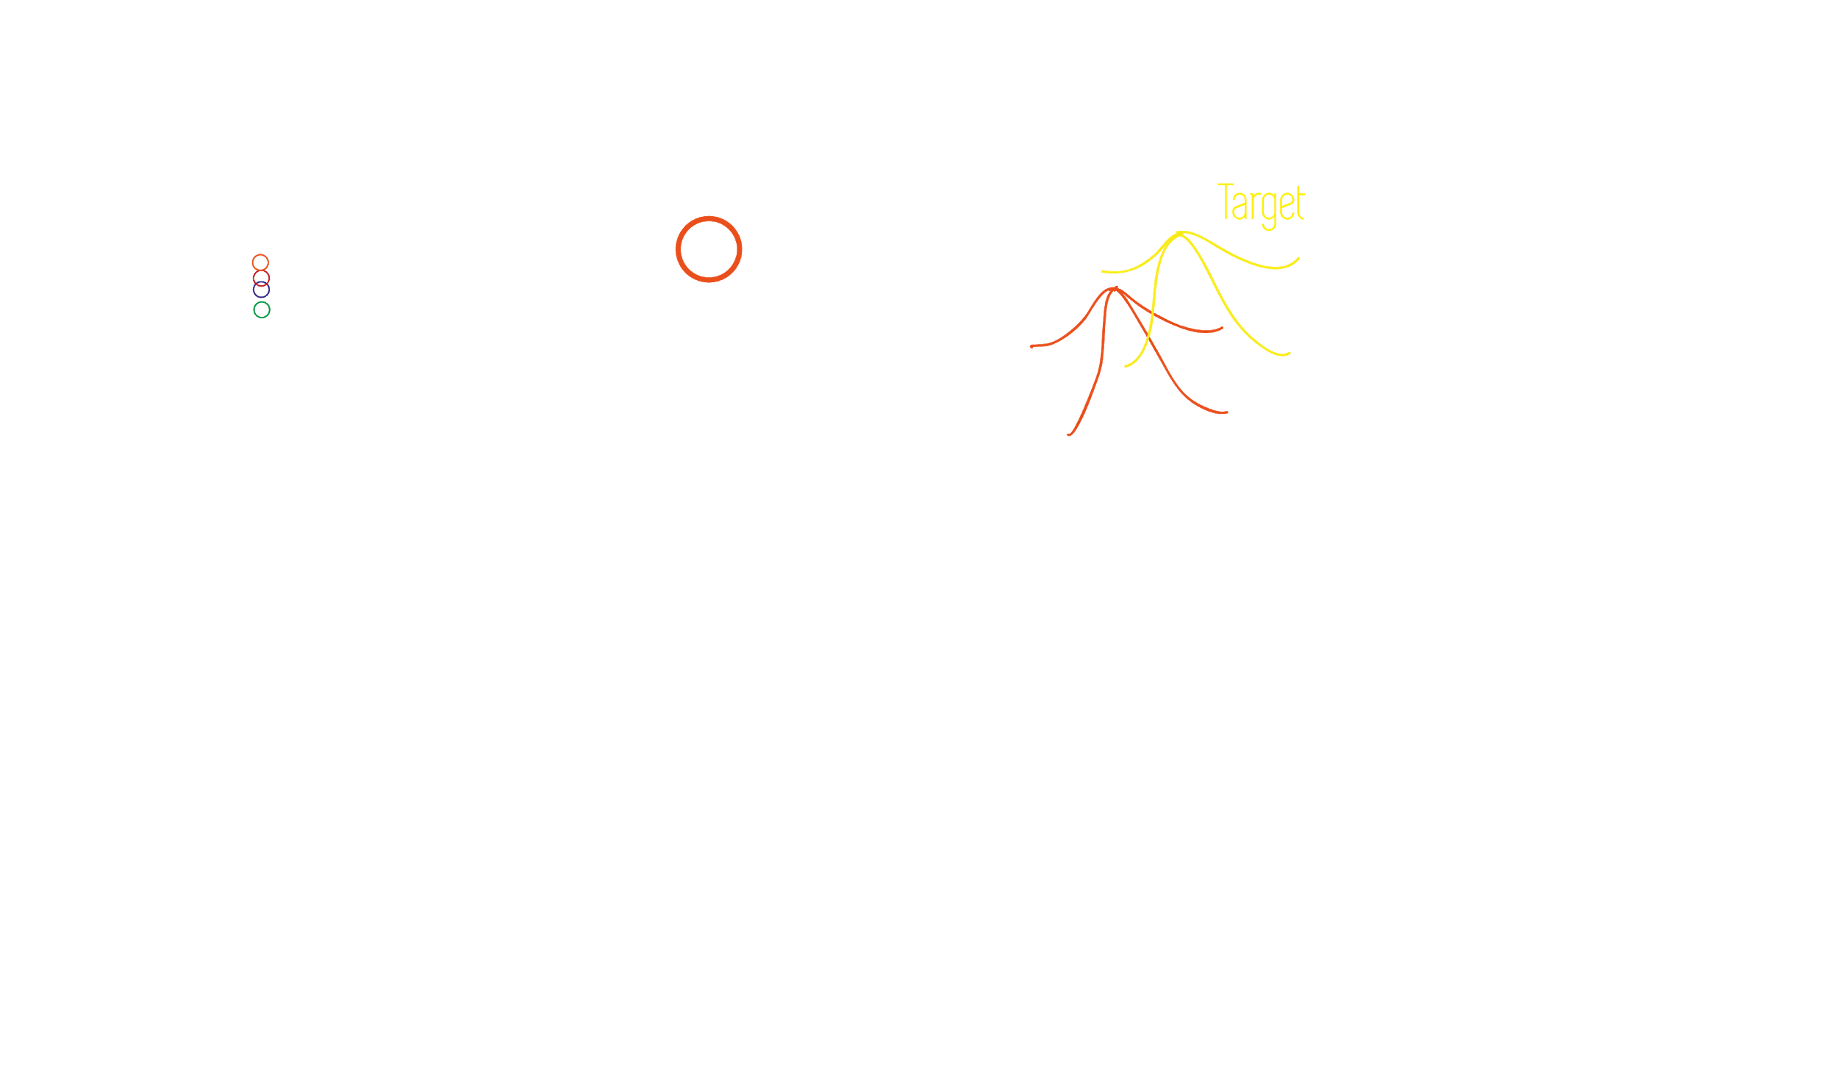
Latent NODE networks

Slide 15
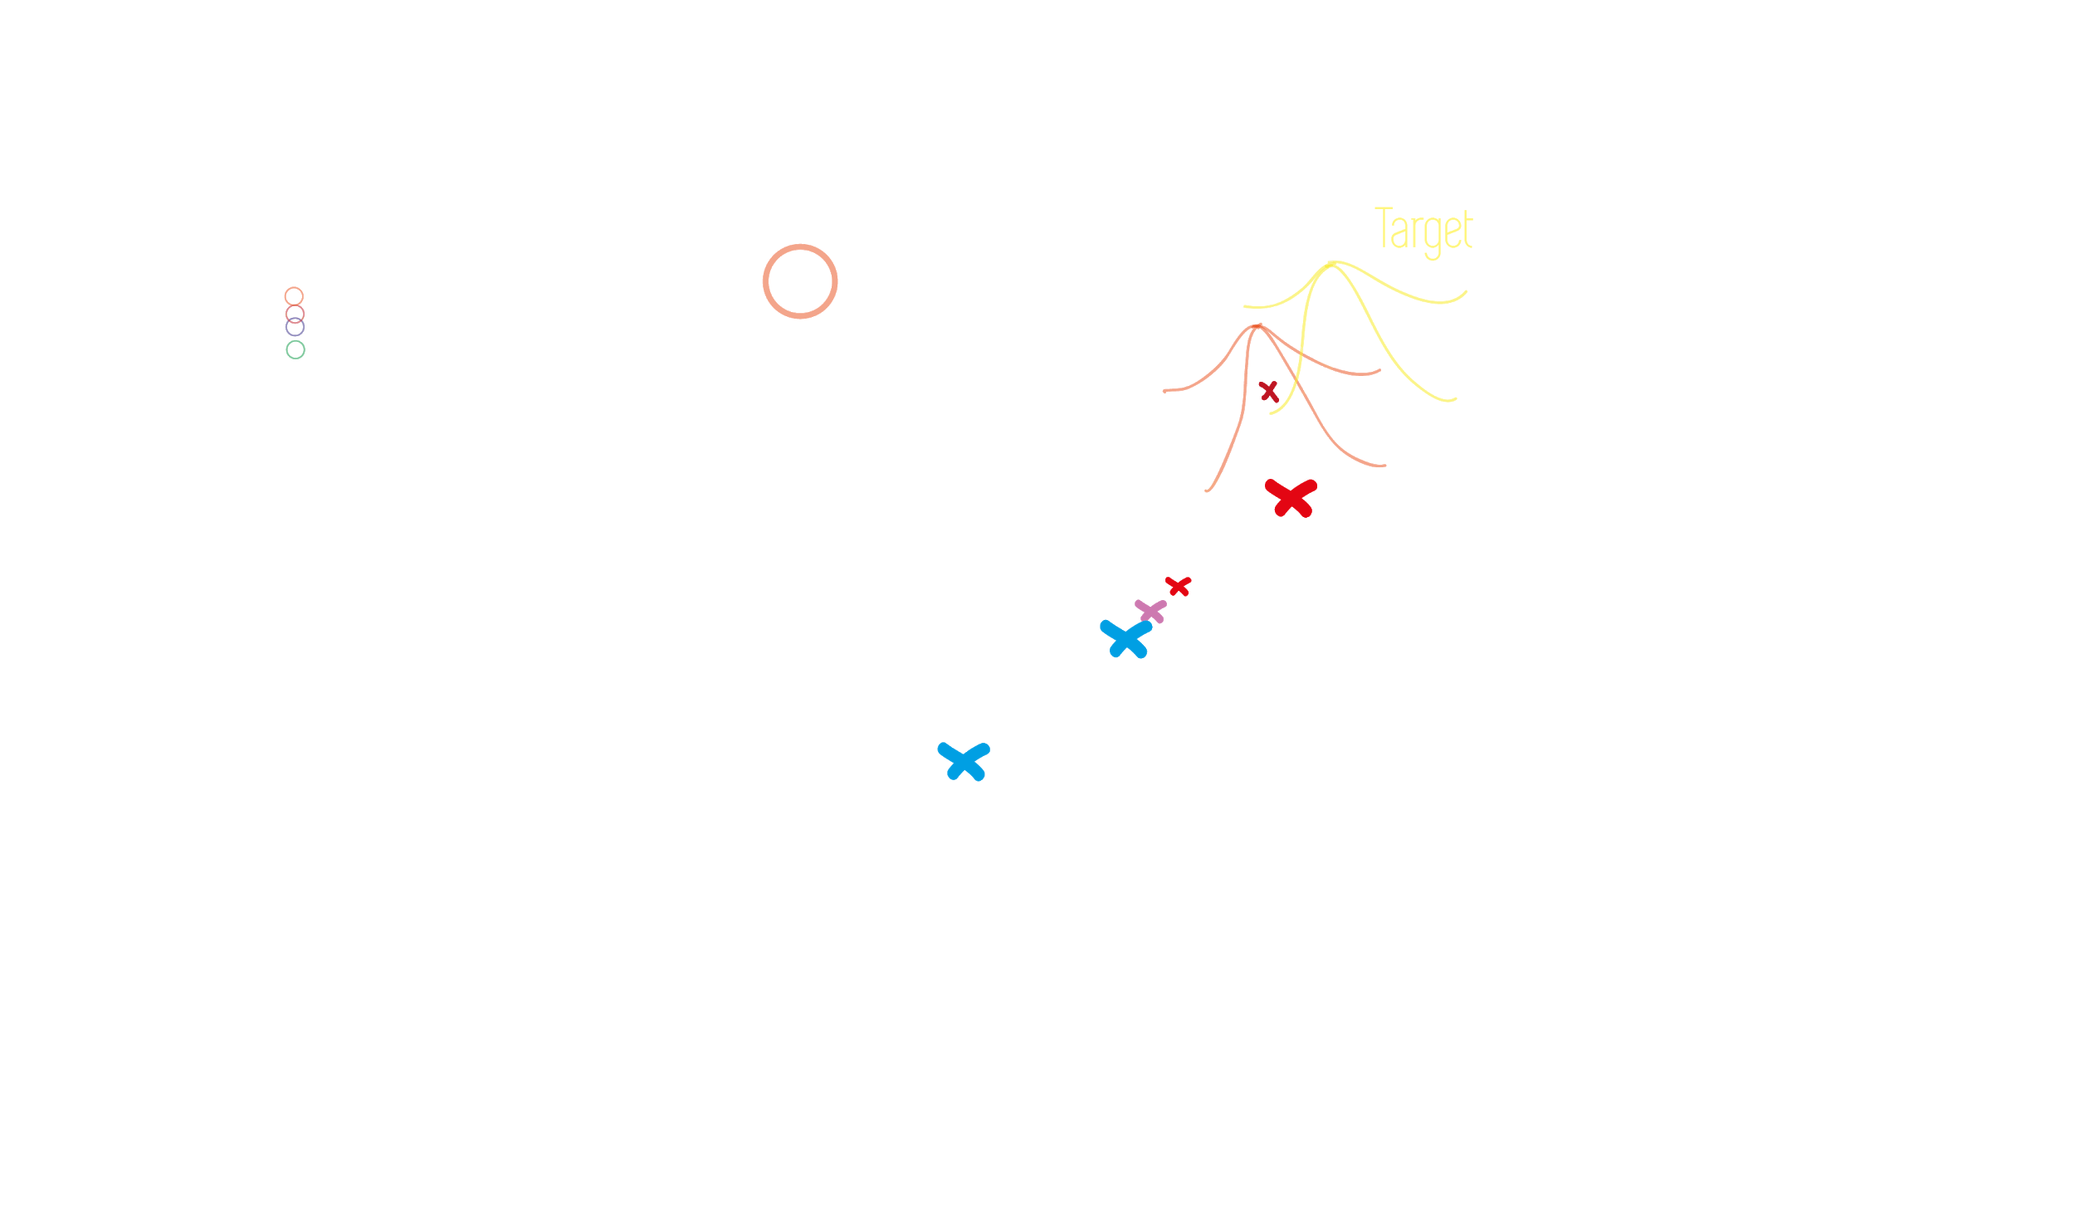
Latent NODE networks

Slide 16
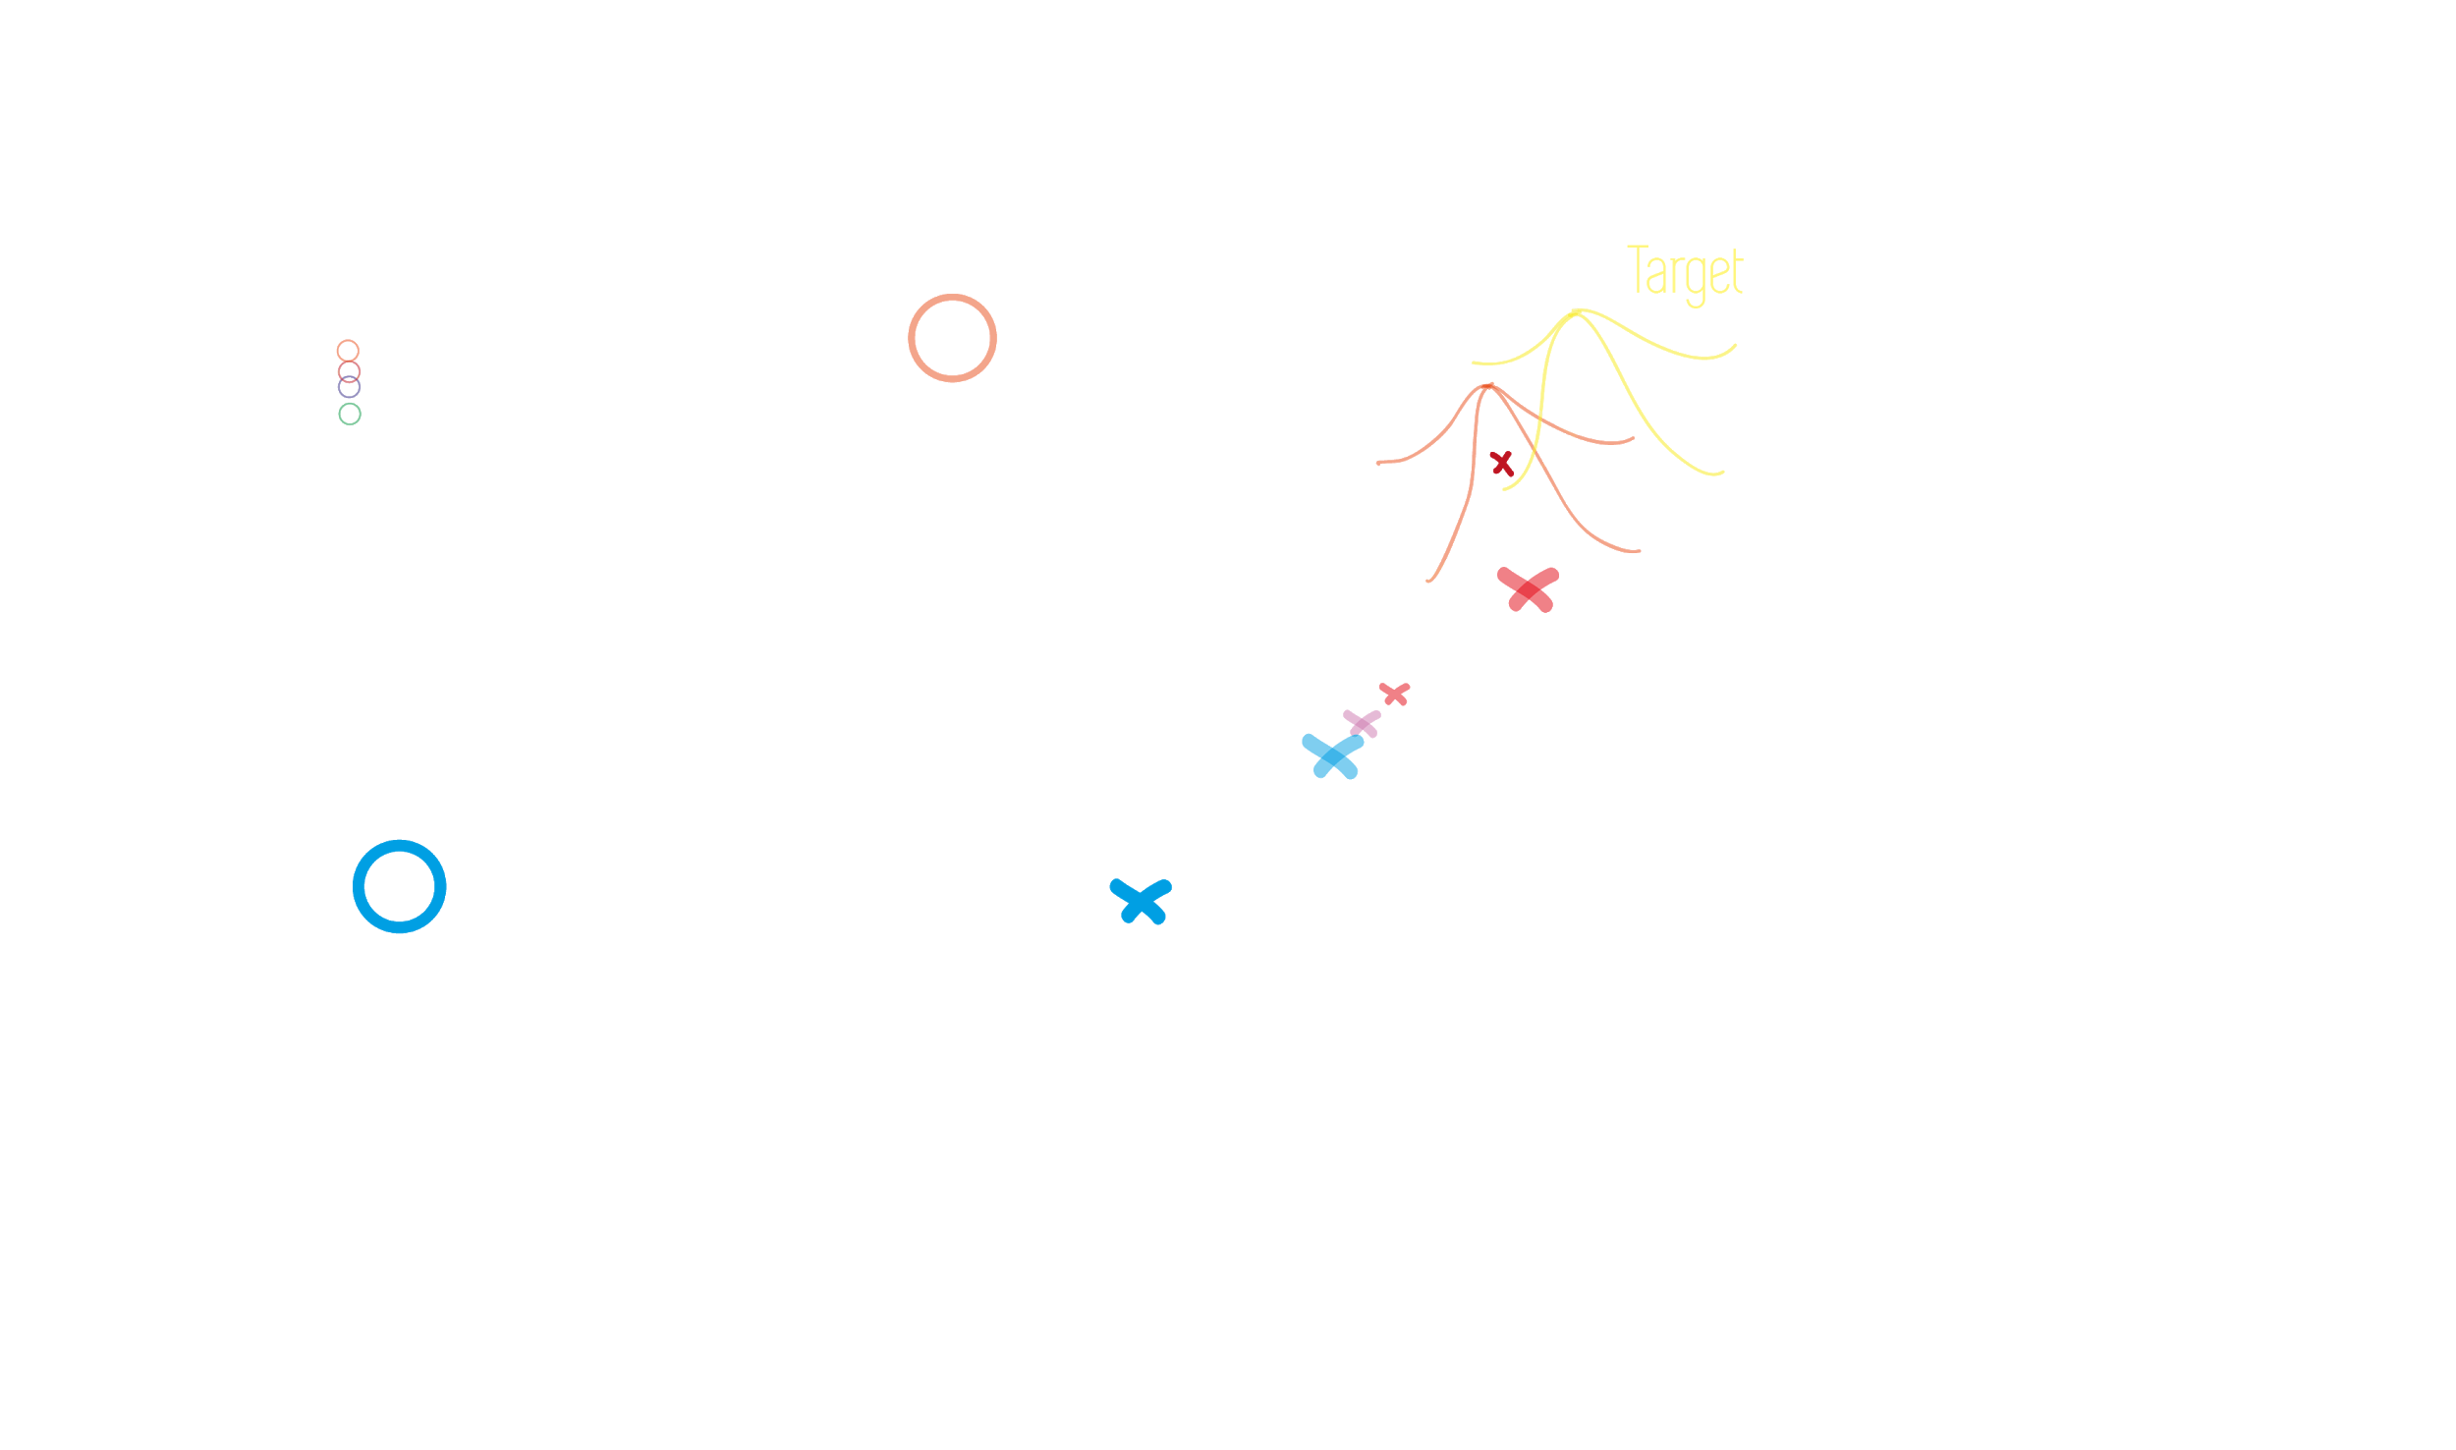
Latent NODE networks

Slide 17
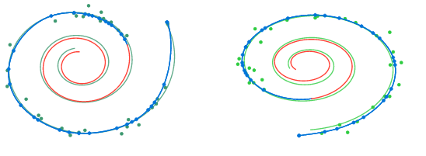
Latent NODE results
RESEARCHERS

Slide 18
Latent NODE results
Eric & Niklas
Latent NODE damped sine

Slide 19
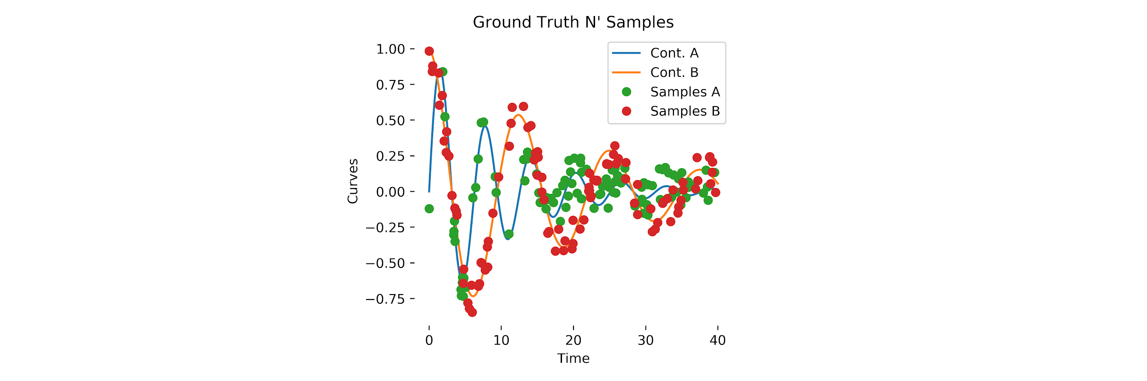
Latent NODE results
Eric & Niklas

Slide 20
Latent NODE results
Eric & Niklas

Slide 21
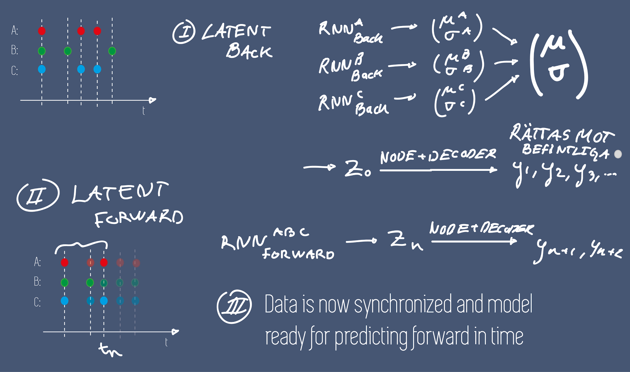
NODE with asynchronous data and
unsynchronized sensors

Slide 22
Latent NODE results
Eric & Niklas

Slide 23
Latent NODE Conclusions
Eric & Niklas
Synchronization complex sensors OK.
Forward prediction failed.

Slide 24
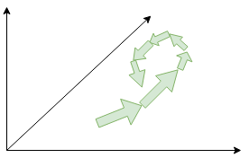
Latent NODE Conclusions
Eric & Niklas
Synchronization complex sensors OK.
Forward prediction failed.
Latent space -

Slide 25
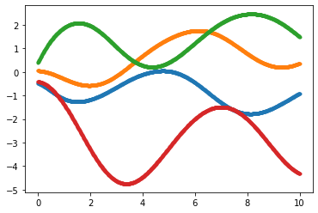
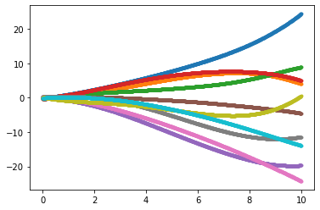
Latent NODE Conclusions
Eric & Niklas
Synchronization complex sensors OK.
Forward prediction failed.
Latent space -
Hidden state Lotka Volterra, 4 vs too many

Slide 26
Improving the RNN
Notes:
Loss function as pleased and defining adjoint state as the derivative w.r.t the hidden states and its derivative w.r.t time/depth is given by adjoint method which is basically chain rule for Loss function, derivatives definition and taylor expansion. Also an ODE which can be solved but backwards in time so we get a(t0)!

Slide 27
Using odes as inspiration for helpful constraints!
Problem: Standard RNNs are not great at remembering long time information.
Standard RNN:
hn+1 = tanh(A*hn + C*Input+bias)
A,C, bias are weight matrices
New RNN idea:
hn+1 = hn + ɣ*tanh(A*hn + C*Input+bias)
Euler discretization??
h’ = tanh(A*hn + C*Input+bias)
What happens if A has imaginary eigenvalues?
Energy/Information conserving
A has to be a antisymmetric matrix
AT=-A

Slide 28
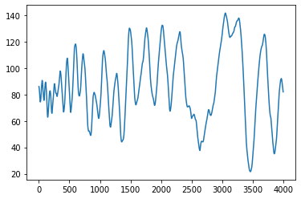
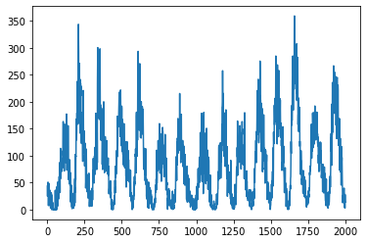
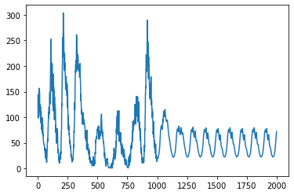
Applying this for time series:
Doing the most stupid approach:
Training it by predicting the next value
Testing it by feeding in the predicted one
Lstm remembered more short behaviour term better
New RNN remembered better the long behaviour better
Sunspots:
My Networks: Target:

Slide 29
Conclusions:
This is a start to a interesting approach, but there is still a lot more research that needs to be done.
It would for example be interesting how it performs on text and speech recognition
In hindsight my way of doing time series is horrible…
So it would also be interesting to see how it performs in a proper time series prediction

Slide 30
More interesting variants of RNNs
What happens if I remove tanh()?
hn+1 = hn + ɣ*(A*hn + C*Input)
This performs slightly worse on the sunspots data
It is way simpler and easier to analyse
It is more stable than using than() as a activation function
Using this it is possible to lift the strict restriction that A has to be antisymmetric without the system always becoming unstable

Slide 31
Could this approach be adapted to synchronise signals?
Goals:
A system that can interpolate the signal
I wanted to use the NODE package again
If I define a hidden state differential equation as:
h’ = A*h + C*Input
Continuous input?? Does that even exist?
Work around: Update the hidden state when Input arrives.
h = h + D*(Predicted output- Actual output)
Lose continuity of the hidden state
Notes:
How to start the system??!
Try to do this on the withe board!!!!!

Slide 32
Interpolating sunspots:
My system:
h’ = A*h
Output’ = U*h’
h = h + D*(Predicted output- Actual output)
The system I have built is a half continuous Kalman filter
The key to success:
Initialisation: A has to have small imaginary eigenvalues
Updating the hidden state

Slide 33
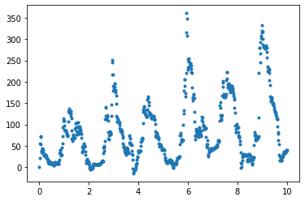
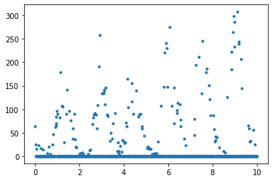
Result:
Input:

Slide 34
Interpolating Sunspots Conclusions:
It is possible to fit a linear system to signals using gradient descent
This could maybe be used to some sort of grey modelling? Were parts of the system are fit with help of gradient descent?
Is gradient descent used in control theory to optimize things like kalman filters?
Using differential equation systems to fit data?

Slide 35
Continuous Normalizing Flows
Notes:
Loss function as pleased and defining adjoint state as the derivative w.r.t the hidden states and its derivative w.r.t time/depth is given by adjoint method which is basically chain rule for Loss function, derivatives definition and taylor expansion. Also an ODE which can be solved but backwards in time so we get a(t0)!

Slide 36
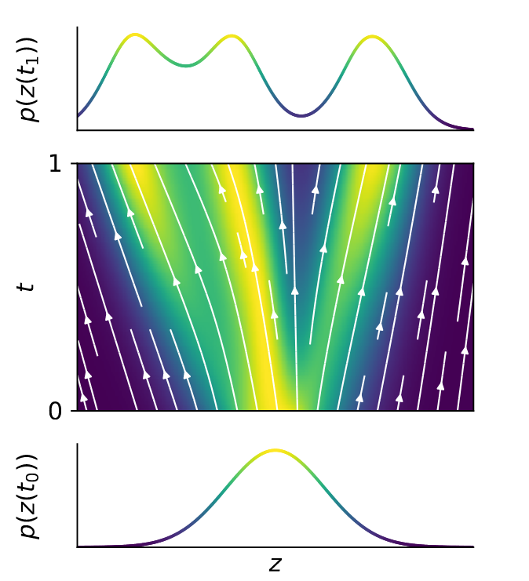
Background CNF

Slide 37
Experiment CNF - Big Bang

Slide 38
Experiment CNF

Slide 39
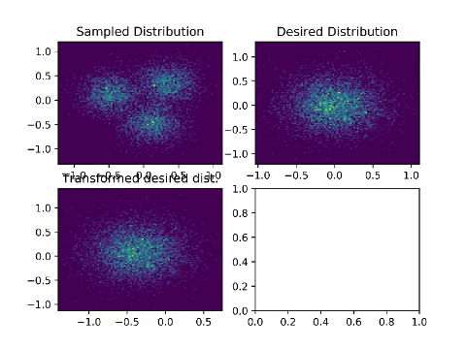
Experiment CNF

Slide 40
Experiment CNF

Slide 41
Experiment CNF

Slide 42
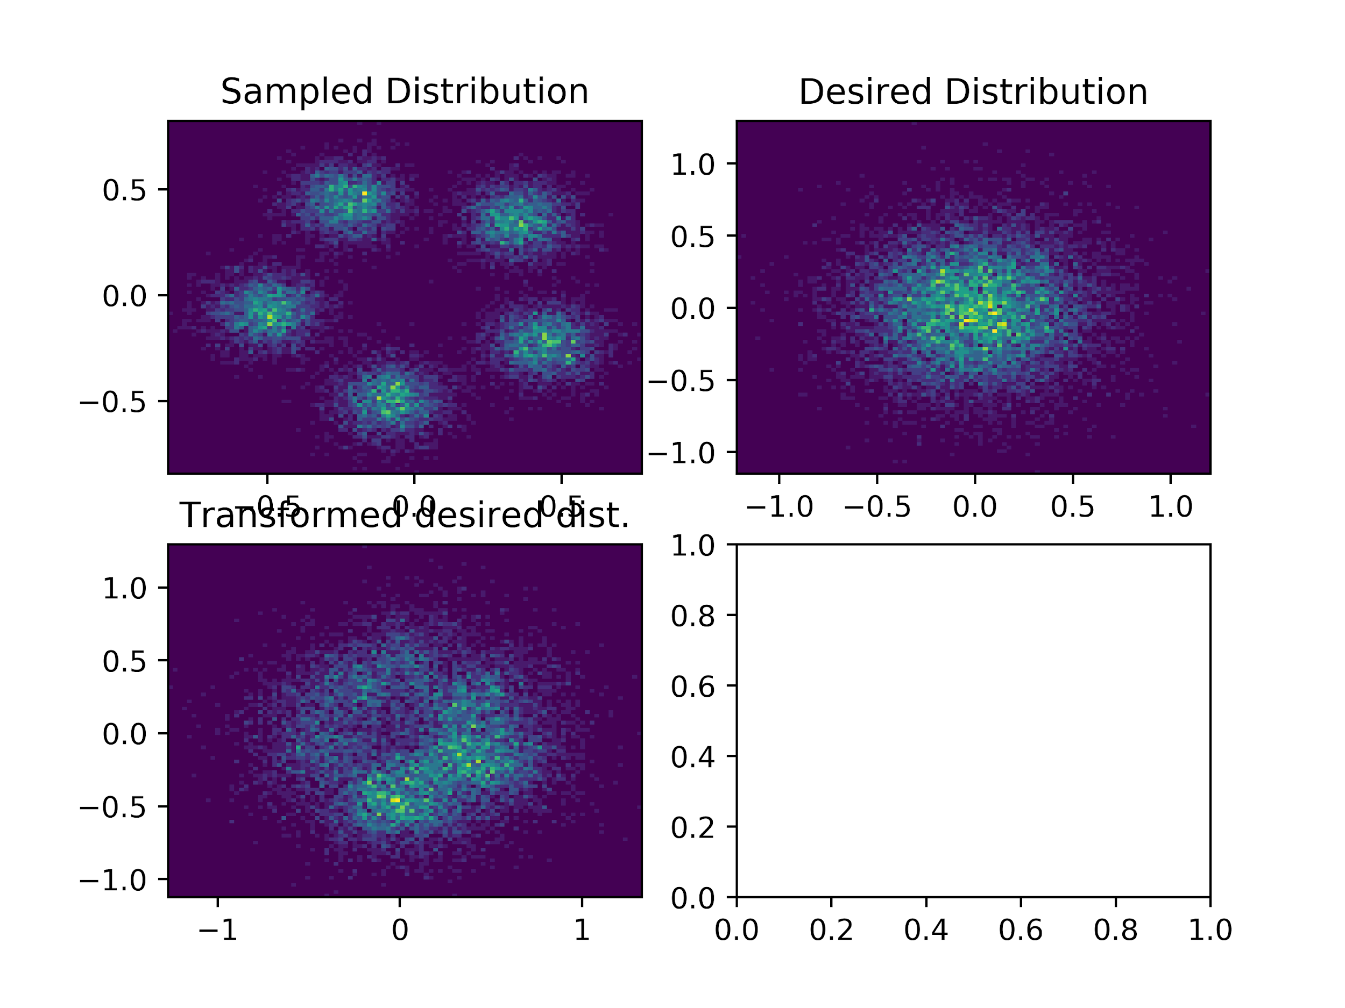
Experiment CNF

Slide 43
Conclusions - CNF
Being able to generate likelihoods for data points can be used for novelty detection
There are also examples of combining this with VAE
Still in the really early stages of development….

Slide 44
Our thoughts in general
Can NODE be used for asynchronous data?
Yes but maybe not the best way?
Arbitrarily timepoints
Trajectories
ODE solvers expensive
Need architectural advantages

